Slide 1
Nook Inc. Frist game: Maze
Wenquan Zhang
Yuekai Wu

Slide 2
Design decisions
We both are fans of ‘The Legend of Zelda: Breath of the Wild’, we likes the ideas of shrines and story.
We decide to make a maze game.
Main theme of the game: a knight comes into a six level tower to save the princess. To achieve this goal, the knight has to defeat the monsters to get his master sword and kill the boss of tower.
We use the image source from a Japanese game ‘魔法の塔’ (Tower of the Sorcerer), because it has useful icons and we can use them to create some simply animation.

Slide 3
Architecture of the game (how to play)
Get a sword and a shield(used to kill monsters)
Explore the map, plan how to use shields(every monster killed consumes a shield)
Find keys and hidden items
Get the strongest sword(can kill boss)
Kill the boss(finish)
Score:
How many shields are left, and the time used

Slide 4
Architecture of the game (program)
GameStart.java -> JFrame class
GamePanel.java ->JPanel class
In GamePanel.java, there are important functions:
1. init() : sets initial data of game, loads the images, sets up the maps.
2.update() : updates the data while the character moves in map
3. paintComponent(Graphics g): draws the main play area and provides the unique digit for each element so we can use these digits to design the maps.
4. keyPressed(KeyEvent e) : control the character to move by four arrow keys

Slide 5





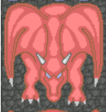





Character, monster and item image
Character |  | Monster
Knight |  | Skull
Princess |  | Elite
 |  | Captain
 |  | Boss: Red Dragon
Item
Sword
Shield
Master sword
Hylian shield
Keys

Slide 6
How java classes are linked together
We only have 2 java classes: GameStart and GamePanel
So just create an object of GamePanel in GameStart…
Classes linked!

Slide 7
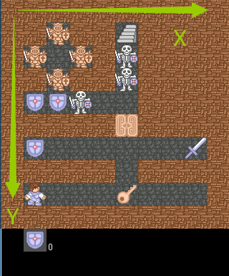
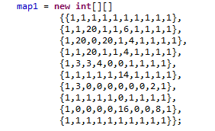
Challenges faced during the project
Create maps
Found a intuitive way to create maps
Numbers represent different items : 0 for floor, 1 for wall, etc.
Caused some problems when using coordinates because the x and y are different

Slide 8
Challenges faced during the project
Player frames
The frames are stored in one array
The player has 4 directions, 3 frames per direction(12 frames in total)
It always displays wrong frame
So we added a playerFrameFixer:
It changes to the index of the first frame of the direction when direction is changed:
When updating the game, use the fixer to avoid problems:

Slide 9
How to improve it in future
More maps
More items
More setting on player and monsters: HP, attack, defense.
Money system.
More sounds: player steps, monster roaring, dying, etc.
Maybe a walking npc(may not, depends on the future game design)
The program is a little bit hard to read, maybe more classes should be used

